Slide 1
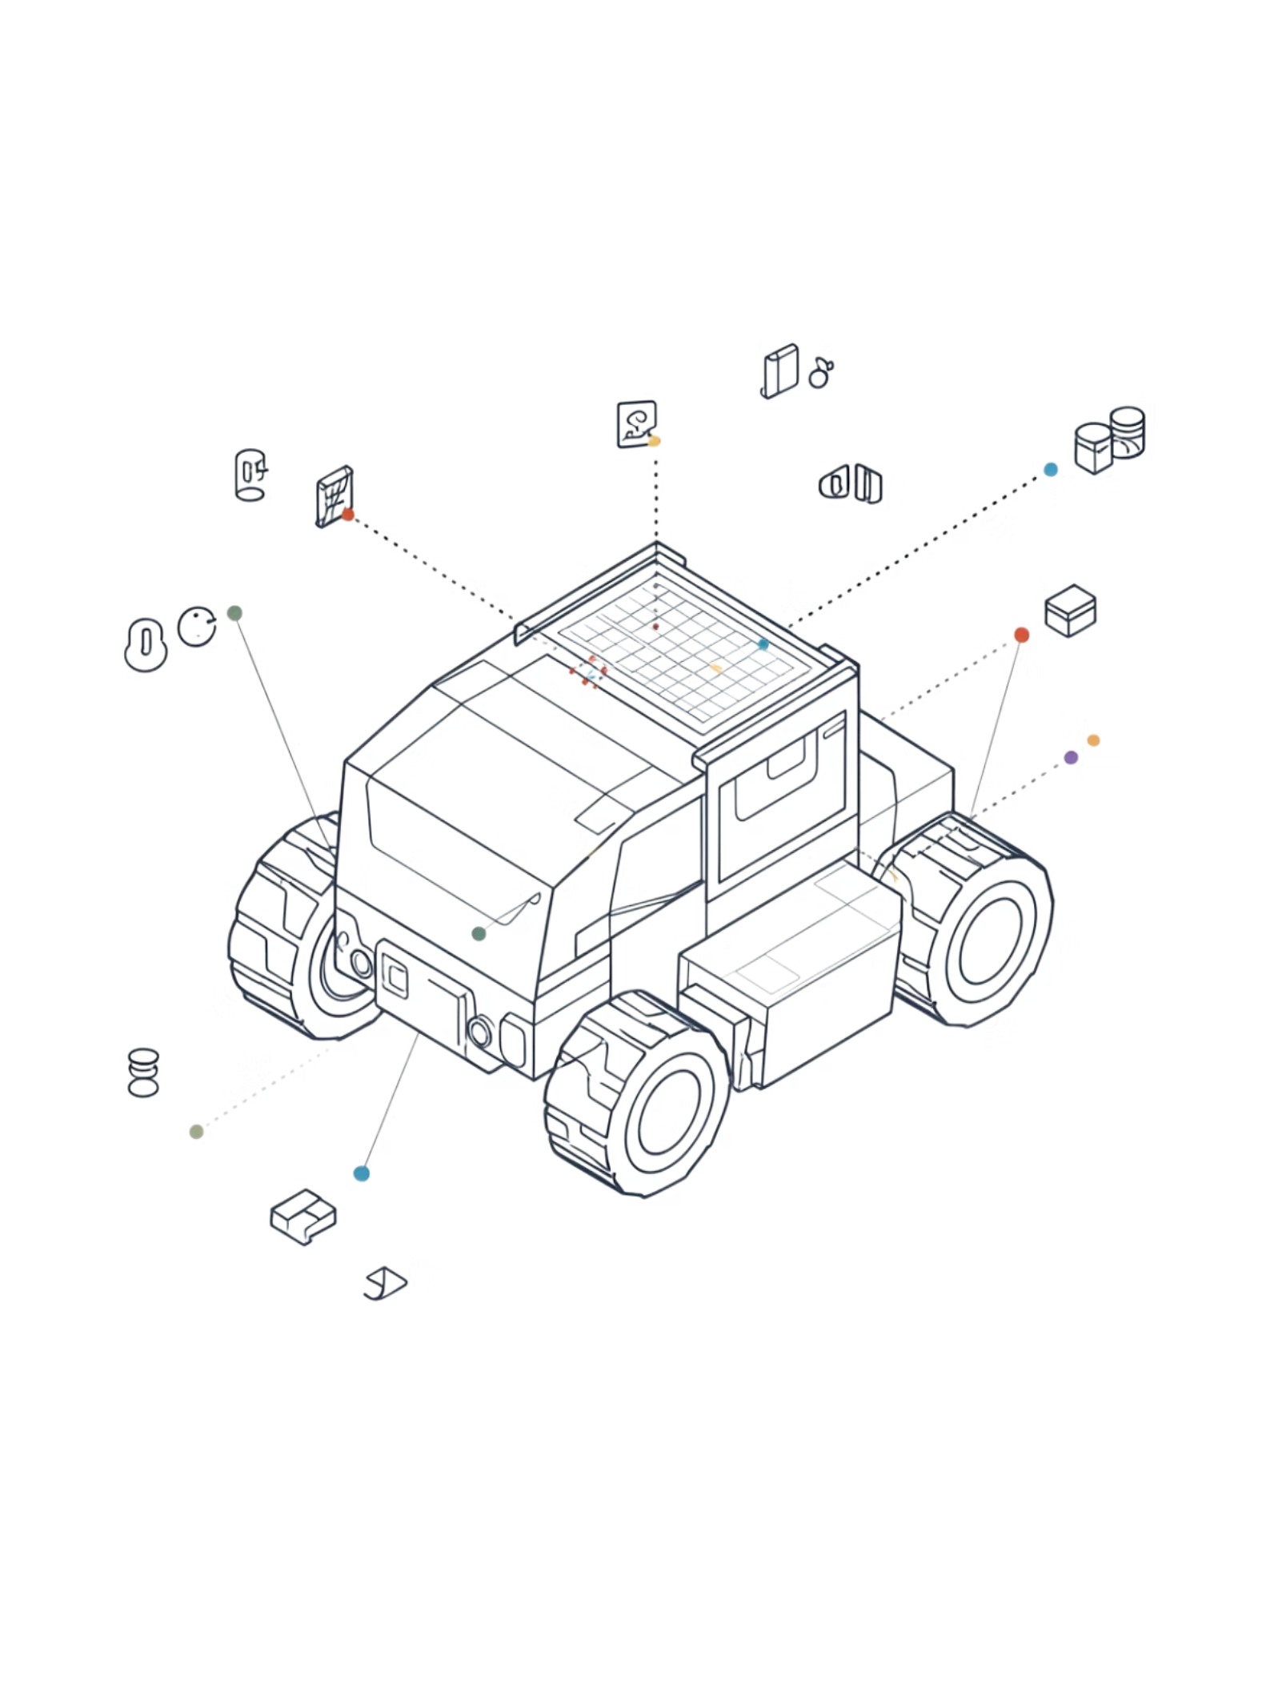
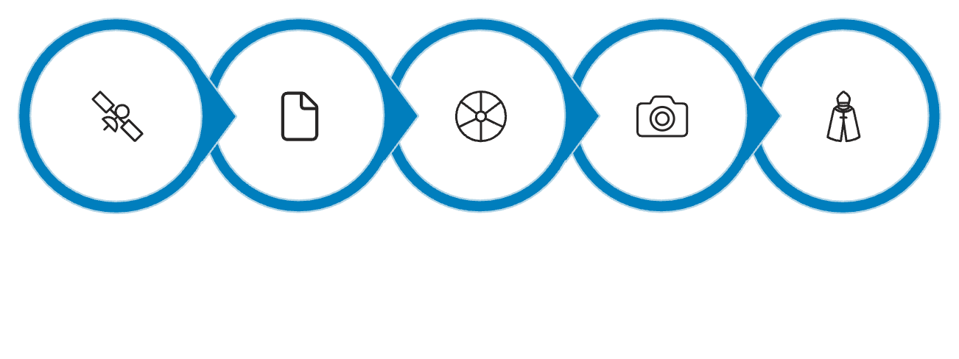





Multi-Sensor Fusion for Mobile Robot Localisation Using Extended Kalman Filter
Dual-EKF Architecture · GPS · IMU · Wheel Odometry · Visual Odometry · LiDAR Odometry
ANISH KUMAR
SACHIT BANSAL
SOMANSHU JUNEJA
GPS
IMU
Wheel Odom
Visual Odom
LiDAR Odom
5 Sensor Modalities
GPS, IMU, Wheel, Visual, LiDAR
Dual-EKF Architecture
Local + Global filter cascade
Data-Driven Noise Tuning
R matrices from stationary logs
Gazebo Ground Truth
Husarion Lynx UGV · ROS 2 Humble
1

Slide 2

Why Localisation is Hard
Goal: the robot must estimate its pose (x, y, θ) in the world at all times — using sensors that each fail in different ways.
GPS — Global but Noisy
IMU — Fast but Drifts
σ ≈ 0.5 m position noise · 10 Hz only · No indoor use · No heading information
150 Hz · Accelerometer drift grows as O(t²) · Bias accumulates over time
Wheel Odometry — Simple but Slips
Visual Odometry — Good Geometry but Jumps
Low noise (σ ≈ 0.03 m/s) · Wheel slip causes unbounded drift · No absolute reference
Geometry-consistent · Loop-closure discontinuities · σ ≈ 0.48 m/s vx noise
Solution: Sensor Fusion. Combine all sensors, weighting by reliability. The EKF maintains a probability distribution over pose and updates it as each sensor measurement arrives.
2

Slide 3


Extended Kalman Filter — Core Idea
The EKF maintains a Gaussian belief N(x̂, P) over the robot state, cycling between two steps: Predict (uncertainty grows) and Update (uncertainty shrinks).
① PREDICT
② UPDATE
State prediction:
Innovation: \nu_t = z_t - h(\hat{x}_t^-)
Kalman Gain:
Covariance prediction:
State update: \hat{x}_t = \hat{x}_t^- + K_t \nu_t
Uncertainty SHRINKS as measurements correct the prediction.
Uncertainty GROWS between measurements. Process noise Q drives the expansion.
15-D State Vector (robot_localization):
x = [ x, y, z, roll, pitch, yaw, vx, vy, vz, vroll, vpitch, vyaw, ax, ay, az ]ᵀ
With two_d_mode: true → effective 6-D: [ x, y, yaw, vx, vyaw, ax ]
3

Slide 4
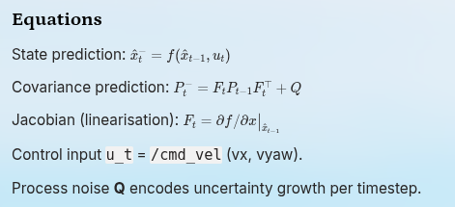




Predict Step — Motion Model Propagation
Between measurements, the filter propagates state and grows uncertainty via the linearised motion model.
Equations
Uncertainty Grows Overtime
State prediction:
At t = 0, Small Ellipse - (Confident)
Covariance prediction:
At t + Delta t, predict only - Ellipse Grows
Jacobian (linearisation):
At t + 2 * Delta t, Measurement - Ellipse Shrinks
Control input u_t = /cmd_vel (vx, vyaw).
Process noise Q encodes uncertainty growth per timestep.
Large Q → fast growth → filter relies more on measurements. Small Q → slow growth → filter trusts its own prediction.
4

Slide 5
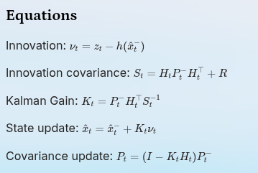

Update Step — Measurement Correction
When a sensor reading arrives, the Kalman Gain optimally blends prediction and measurement — weighted by their respective uncertainties.
Equations
Innovation: \nu_t = z_t - h(\hat{x}_t^-)
Predicted State (wider = uncertain)
Measurement (narrower = known R)
Fused result (narrowest, between both)
Innovation covariance: S_t = H_t P_t^- H_t^\to
Kalman Gain: K_t = P_t^- H_t^\top S_t^{-1}
Represents the prior estimate before measurement correction, with greater uncertainty shown by a wider spread.
The sensor observation is more precise when measurement noise R is small, so the distribution appears narrower.
The corrected estimate combines both sources and typically lands between prediction and measurement with reduced uncertainty.
Covariance update: P_t = (I - K_t H_t) P_t^-
K → 0 if R large (noisy sensor) → trust prediction. K → 1 if P large (uncertain model) → trust measurement.
5

Slide 6
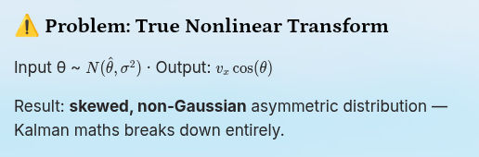
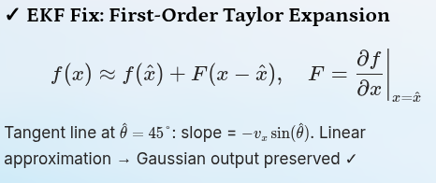


Linearisation — Why "Extended" Kalman Filter
Robot motion is nonlinear: a Gaussian input through a nonlinear function does not produce a Gaussian output.
The EKF linearises via a first-order Taylor expansion to preserve the Gaussian form.
⚠ Problem: True Nonlinear Transform
✓ EKF Fix: First-Order Taylor Expansion
Input θ ~ N(\hat{\theta}, \sigma^2) · Output: v_x \cos(\theta)
Result: skewed, non-Gaussian asymmetric distribution — Kalman maths breaks down entirely.
Tangent line at \hat{\theta} = 45°: slope = -v_x \sin(\hat{\theta}). Linear approximation → Gaussian output preserved ✓
Valid only when uncertainty is small — the input Gaussian must remain within the linear region. High angular velocity can cause divergence.
6

Slide 7
EKF Assumptions & When They Break
Understanding the limitations of the linearised Gaussian approximation is essential for robust deployment.
Gaussian Noise
Locally Linear Dynamics
Assumption: w ~ N(0, Q), v ~ N(0, R)
Assumption: Nonlinearity mild enough for 1st-order Taylor expansion
Reality: GPS has non-Gaussian outliers from multipath reflections. Handled via Mahalanobis distance rejection threshold.
Reality: Fails at high angular velocity or sharp turns — EKF can diverge under strong nonlinearity.
Known Noise Covariances
Independent Noise
Assumption: Q and R are accurately modelled
Assumption: Process and measurement noise uncorrelated across timesteps
Handled ✓ R values measured from real stationary sensor logs. Data-driven tuning is a core contribution of this project.
Reality: Wheel slip introduces correlated error. Mitigated by fusing velocity, not position, from wheel odometry.
7

Slide 8
Five Sensor Modalities — What Each Provides
Each sensor contributes where it is strongest. Noise parameters were measured from 60-second stationary logs in Gazebo.
Sensor
ROS Topic
Rate
Measures
Noise Characteristics
Role in EKF
IMU (9-DOF)
/imu/data
150 Hz
Accel (ax,ay,az)
Gyro (gx,gy,gz)
Accel σ ≈ 0.98 m/s² · Gyro σ ≈ 0.015 rad/s · Bias drift
Short-term orientation dead-reckoning
GPS (NavSat)
/gps/fix
10 Hz
Lat, Lon, Alt
Position σ ≈ 0.5 m · Outlier spikes · No heading
Global position anchor
Wheel Odometry
/diff_drive_controller/odom
38.6 Hz
Pose (integrated)
Twist (vx, vyaw)
Low σ ≈ 0.03 m/s vx · Slip accumulates
Primary velocity source
Visual Odom (RTAB-Map)
/odometry/visual
14.3 Hz
Pose from camera features
σ ≈ 0.48 m/s vx · Loop-closure jumps
Geometry-consistent relative motion
LiDAR Odom (rtab ICP)
/odometry/lidar
3.9 Hz
Pose from point cloud
σ ≈ 0.29 m/s vx · Low angular noise
Most reliable geometry · Best loop closure
8

Slide 9
IMU — Inertial Measurement Unit
Fast, noisy, drifts — but essential for orientation. The IMU runs at 150 Hz, providing the highest-frequency input to the filter.
Physical Principle & ROS Configuration
Measured Noise — Stationary 60 s
Accelerometer: measures specific force (accel − gravity). Double integration gives position — noise accumulates as O(t²), quadratic drift.
Accel X var=0.969 σ=0.985 m/s²
Accel Y var=0.565 σ=0.752 m/s²
Accel Z var=0.691 σ=0.831 m/s²
Gyro X var=0.000226 σ=0.015 rad/s
Gyro Y var=0.001462 σ=0.038 rad/s
Gyro Z var=0.0416 σ=0.204 rad/s
Gyroscope: measures angular rate. Single integration gives orientation. Drift is O(t) — linear.
imu0_remove_gravitational_acceleration: true — subtracts 9.81 m/s² from az before fusion
imu0_differential: true — no magnetometer in simulation → only change in angle is fused, eliminating the 150° heading runaway seen in early experiments
Orientation rows (4–6) DISABLED — fusing both orientation and angular velocity would double-count the biased gyro signal
Key insight: Gyro Z variance (0.0416) is 184× larger than Gyro X (0.000226)
Yaw is the weakest IMU channel
9

Slide 10

Wheel Odometry — Dead Reckoning from Encoders
Reliable, high-rate velocity source. The critical design decision: fuse velocity, not absolute position — preventing wheel slip drift from contaminating the global estimate.
Differential Drive Kinematics
EKF Config (odom0)
# Forward arc and heading change
ΔS = (ΔS_right + ΔS_left) / 2
Δθ = (ΔS_right - ΔS_left) / wheel_base
x = x + ΔS · cos(θ + Δθ/2)
y = y + ΔS · sin(θ + Δθ/2)
θ = θ + Δθ
odom0_config: [false, false, false, # x, y, z: DISABLED false, false, false, # roll,pitch,yaw: OFF true, false, false, # vx: ENABLED false, false, true, # vyaw: ENABLED false, false, false] # accel: OFF # vy = 0 mechanically (diff drive) # cannot move side ways
Why fuse velocity, not position? Fusing absolute wheel odom position couples the EKF to accumulated slip drift. Fusing only vx and vyaw lets GPS independently correct global position — no drift coupling.
odom0_relative: false → measurements in global odom frame
odom0_differential: false → wheel odom is stable (no loop closure)
Noise: std_dev ≈ 0.03 m/s → low covariance in YAML config
Measured: vx σ ≈ 0.03 m/s — very clean signal in Gazebo simulation.
10

Slide 11
Visual Odometry & LiDAR Odometry
Geometry-consistent odometry sources with loop-closure discontinuities — requires differential mode for stable EKF integration.
VISUAL ODOMETRY — RTAB-MAP
LIDAR ODOMETRY — rtab ICP
Real-time feature matching across frames; homography / essential matrix for camera motion
Loop-closure detection corrects drift via a sudden absolute pose jump (+2 m) → EKF diverges
Fix: odom1_differential: true → EKF computes Δpose; large jumps rejected by pose_rejection_threshold: 1.5 (Mahalanobis)
Noise: σ ≈ 0.48 m/s for vx (starburst interference on agricultural tiles); covariance set to 0.5
Iterative Error State KF (IESIKF) — tightly coupled IMU + LiDAR
ICP-variant: registers 3D point cloud against local map; no visual features → works in low-texture environments
Loop-closure discontinuities still present → same differential: true treatment
vx σ ≈ 0.29 m/s; vyaw σ ≈ 0.21 rad/s; covariance: 0.02 (more trusted than VO)
pose_rejection_threshold: 2.0 — cleaner signal allows more measurements through
11

Slide 12


GPS Integration — From Lat/Lon to Local XY
navsat_transform_node bridges WGS84 coordinates and the EKF's metric frame.
NavSat Transform Algorithm
Measured GPS Noise — Stationary 60 s
01
02
Axis
Variance
Std Dev
Notes
Wait 3.0 s
Record Origin Datum
Latitude
0.263 m²
0.51 m
Satellite drift + multipath
Allow EKF to stabilise heading before accepting GPS fixes.
First GPS fix becomes the local coordinate origin (lat₀, lon₀).
Longitude
0.245 m²
0.49 m
Slightly better than lat
03
04
Project to Metric XY
Rotate into EKF Frame
Altitude
1.230 m²
1.11 m
Worst axis (vertical geometry)
x = (lat − lat₀) × 111320 | y = (lon − lon₀) × 111320 × cos(lat₀)
Apply IMU heading at initialisation; output /odometry/gps → fused into EKF #2.
Random walk radius: ~1 m over a 60-second window.
05
EKF config: only x,y fused from GPS
No GPS Heading
At low speed, two consecutive positions have noise-to-signal too high. Heading comes from IMU only.
odom1_config:
[true, true, false, # x, y: ENABLED
false, false, false, # orientation: DISABLED
false, false, false, # (GPS has no heading)
false, false, false,
false, false, false]
No GPS heading: at low speed, two consecutive positions have noise-to-signal too high. Heading comes from IMU only.
12

Slide 13

Dual EKF Architecture — Why One EKF Is Not Enough
Separates smooth local estimation from globally-bounded GPS correction.
✗ Single EKF + GPS
✗ Single EKF without GPS
✓ Dual EKF Solution
GPS at 10 Hz, σ ≈ 0.5 m
Growing uncertainty between updates
GPS arrival → EKF snaps toward fix
Result: visible jitter — downstream planners receive jerky poses
Wheel + IMU sources only
Drift accumulates unboundedly
No global correction mechanism
Error grows linearly with distance (confirmed in baseline tests)
EKF #1 - Local (odom frame)
Fuses: Wheel + VO + LiDAR + IMU
No GPS → smooth, continuous
Publishes: odom→base_link TF
Output: /odometry/local
EKF #2 - Global (map frame)
Fuses: All above + GPS
GPS → globally bounded drift
Publishes: map→odom TF
Output: /odometry/global
How the Two EKFs Interact
EKF #1 provides smooth high-frequency estimate (50 Hz) for local navigation.
EKF #2 computes the map→odom correction offset at ~10 Hz (GPS-driven).
GPS correction in EKF #2 shifts the local frame — NO jitter reaches EKF #1.
Global pose = (map→odom from EKF #2) ∘ (odom→base_link from EKF #1). EKF #2 shifts the local frame at ~10 Hz — EKF #1 remains smooth and unaffected.
13

Slide 14
ROS2 Node Graph — The Local-Global Feedback Loop
How navsat_transform_node couples EKF #1 and EKF #2 into a closed feedback architecture.
Node Topology
/imu/data ──
14

Slide 15

Sensor Noise Characterisation — How R Values Were Derived
Stationary robot recorded for 60 s; any non-zero variance is pure sensor noise, directly used to populate measurement covariance matrix R.
Channel
Mean
Variance
Std Dev
Notes
GPS Latitude
~0
0.263 m²
0.51 m
Random walk + satellite drift
GPS Longitude
~0
0.245 m²
0.49 m
Slightly better than lat
GPS Altitude
~0
1.230 m²
1.11 m
Worst GPS axis (vertical geometry)
IMU Gyro X
~0
0.000226 (rad/s)²
0.015 rad/s
Clean, good axis
IMU Gyro Y
~0
0.001462 (rad/s)²
0.038 rad/s
Moderate
IMU Gyro Z
~0
0.041601 (rad/s)²
0.204 rad/s
⚠️ Highest — yaw drift
IMU Accel X
~0
0.969666 (m/s²)²
0.985 m/s²
Very high — vibration
IMU Accel Y
~0
0.565310 (m/s²)²
0.752 m/s²
High
IMU Accel Z
~9.81
0.691300 (m/s²)²
0.831 m/s²
Gravity ± noise
Wheel Odom vx
~0
~0.001 (m/s)²
0.032 m/s
Very clean (Gazebo)
IMU Gyro Z variance (0.0416) is 184× larger than Gyro X (0.000226). Yaw estimation from raw IMU is the weakest channel → LiDAR odometry is the primary yaw source.
15

Slide 16
Sensor Configuration Vectors — What Each true/false Means
A 15-element boolean vector selects which state dimensions each sensor updates in the EKF.
# Index: 0 1 2 3 4 5 6 7 8 9 10 11 12 13 14
# State: x y z roll pitch yaw vx vy vz vroll vpitch vyaw ax ay az
Wheel Odometry (odom0)
IMU (imu0)
LiDAR Odom (odom2)
[false,false,false, # x,y,z: DISABLED — abs pos drifts
false,false,false, # roll,pitch,yaw: no heading
true, false,false, # vx: ENABLED — forward velocity
false,false,true, # vyaw: ENABLED — turn rate
false,false,false] # accel: DISABLED
[false,false,false, # position: none
false,false,false, # orientation: DISABLED
false,false,false, # velocity: not measured
true, true, true, # vroll,vpitch,vyaw: ENABLED
true, true, true] # ax,ay,az: ENABLED
[true, true, false, # x,y: ENABLED — scan match
false,false,true, # yaw: ENABLED — scan heading
false,false,false, # velocities: DISABLED
false,false,false,
false,false,false] # differential: true
vy = 0 mechanically — differential drive cannot move sideways.
Orientation DISABLED — no magnetometer → 150° drift observed when rows were enabled.
differential: true — use Δpose, not absolute pose. Prevents loop-closure jumps.
16

Slide 17

Process Noise Covariance Q — Tuning Uncertainty Growth
Q controls how fast the filter distrusts its own prediction between measurements.
Q Tuning Principle
State
Q Value
Justification
Derivation
High Q → uncertainty grows fast → filter trusts next measurement heavily
Low Q → uncertainty grows slowly → filter trusts its own motion model
x position
0.025
Tightened from 0.05 — LiDAR reliable
Δx at 50 Hz, 0.5 m/s ≈ 0.01 m → Q ≈ 0.01²×2.5 = 0.025
y position
0.025
Same as x (symmetric ground robot)
Symmetric treatment
Q ≈ (expected state change per timestep)² × safety_factor. The 15×15 Q matrix is diagonal — state dimensions assumed independently uncertain.
z position
0.06
Looser — ground robot, z not critical
Not safety-critical
yaw
0.08
Gyro Z is noisiest IMU channel (var=0.0416)
Δθ per step ≈ 0.029 rad → Q_yaw ≈ 0.06
vx
0.04
Raised from 0.025 — wheel slip on varied terrain
Accounts for slip uncertainty
vyaw
0.04
Wheel + IMU both contribute
Moderate uncertainty between updates
ax, ay
0.01
Accelerations change slowly on ground robot
Small step-to-step change expected
17

Slide 18

Initial Estimate Covariance P₀ — Startup Uncertainty
P₀ encodes how certain we are about the robot's state at t = 0. The two EKFs require fundamentally different initialisations.
EKF #1 — Local (odom frame)
EKF #2 — Global (map frame)
initial_estimate_covariance:
diagonal value = 1e-9
initial_estimate_covariance:
x, y, vx, vy = 1e-9 m² / (m/s)²
Robot starts at known origin (0, 0, 0)
odom frame is defined relative to start — initial pose is exact by definition
Near-zero uncertainty → EKF trusts its initial state fully
Avoids unnecessary filter relaxation at startup
map frame = real-world absolute frame
Before the first GPS fix, global position is completely unknown
Large P₀ forces EKF to trust the first GPS measurement heavily
Enables fast initial convergence to GPS position
Asymmetric P₀ is intentional: local certainty vs. global ignorance.
18

Slide 19
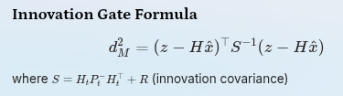
Mahalanobis Distance Gates — Outlier Rejection
Adaptive threshold based on current filter uncertainty P — the gate opens when the filter is uncertain and tightens as it converges.
Innovation Gate Formula
Per-Sensor Gate Configuration
Sensor
Threshold
σ Noise
Reason
where S = H_t P_t^- H_t^\top + R (innovation covariance)
Visual Odom pose
1.5
0.48 m/s
Noisy — aggressive rejection (~13% under Gaussian)
P large → gate OPENS
P small → gate TIGHTENS
LiDAR Odom pose
3.0
0.07 m/s
Cleaner signal — allow more through (~5% rejected)
Filter uncertain; more measurements pass through.
Filter converged; only close measurements accepted.
GPS position
3.0
0.5 m
Known noise level — standard gate
IMU pose
0.8
high
Aggressive — raw IMU full noise
Measurements inside the 2σ uncertainty ellipse are accepted; those outside are rejected. Ellipse adapts dynamically with P.
IMU twist
0.8
high
Gyro Z large variance
IMU accel
0.8
0.98 m/s²
Accelerometer very noisy
19

Slide 20
Differential Mode — Relative vs. Absolute Pose Fusion
Isolates loop-closure jumps for rejection without discarding valid relative motion increments.
✗ Problem: Absolute Pose Fusion
✓ Solution: Differential Mode
VO publishes absolute poses in its own frame
RTAB-Map loop closure: x = 5.0 m → x = 7.0 m in one step
EKF sees a sudden +2 m jump
Violates smooth-motion assumption → filter diverges
odom1_differential: true
# EKF computes relative transform:
z_k = T(t_{k-1})^{-1} · T(t_k)
# Loop closure: Δx = 2.0 m
→ d_M >> 1.5 → REJECTED
# Normal motion: Δx = 0.01 m
→ ACCEPTED
Absolute vs. Differential — Timeline
Mode
t=1
t=2
t=3
t=4
t=5 (closure)
t=6
Absolute x
1.0
2.0
3.0
5.0
7.0
8.0
Δx (diff)
Δ1.0
Δ1.0
Δ1.0
Δ1.0
REJECT
Δ1.0
When NOT to use differential: Wheel odom (already a rate signal) and GPS (removes the global correction benefit).
20

Slide 21


Control Input Fusion — Using /cmd_vel for Better Prediction
Incorporating commanded velocity into the predict step reduces prediction error
Without control input
Configuration
Predict step assumes CONSTANT VELOCITY. When robot accelerates/decelerates or turns, prediction error grows.
use_control: true
control_config: [true, false, false, false, false, true]
# vx only + vyaw only (diff drive, no vy)
acceleration_limits: [1.0, 0.0, 0.0, 0.0, 0.0, 1.5] # max m/s² and rad/s²
deceleration_limits: [1.0, 0.0, 0.0, 0.0, 0.0, 1.5]
acceleration_gains: [0.8, 0.0, 0.0, 0.0, 0.0, 0.9] # trust new cmd
deceleration_gains: [1.0, 0.0, 0.0, 0.0, 0.0, 1.0]
With use_control: true — EKF incorporates /cmd_vel into prediction:
x̂_predict = f( x̂, u_cmd_vel )
Prediction Quality Comparison
Without Control
Predicted trajectory is a straight line regardless of actual curve. Large residual when sensor arrives. Noisy updates.
With Control
Predicted trajectory follows commanded turn. Smaller innovation (residual) when sensor arrives. More stable filter, fewer large corrections.
21

Slide 22
Frame Configuration — odom vs. map World Frame
TF hierarchy and two_d_mode effects on the state vector.
TF Frame Hierarchy
EKF #1 — world_frame: odom
EKF #2 — world_frame: map
map (GPS-corrected global)
│ ← EKF #2 publishes map→odom
odom (local smooth frame)
│ ← EKF #1 publishes odom→base_link
base_link (robot body)
├── imu_link
├── gps_link
├── camera_link
└── lidar_link (/tf_static)
Maintains odom→base_link. Smooth, continuous at 50 Hz. No GPS — drifts over time, but drift is smooth. Used for local navigation and control.
Maintains map→odom as a slowly-updated correction offset. GPS shifts this offset to correct global position without disrupting the smooth odom frame.
two_d_mode: true
Forces z=0 (ground robot). Removes roll/pitch from state. Zeroes z, roll, pitch rows in Q, P, and sensor config. Reduces effective state 15D → 6D. Faster computation, no 3D drift.
22

Slide 23
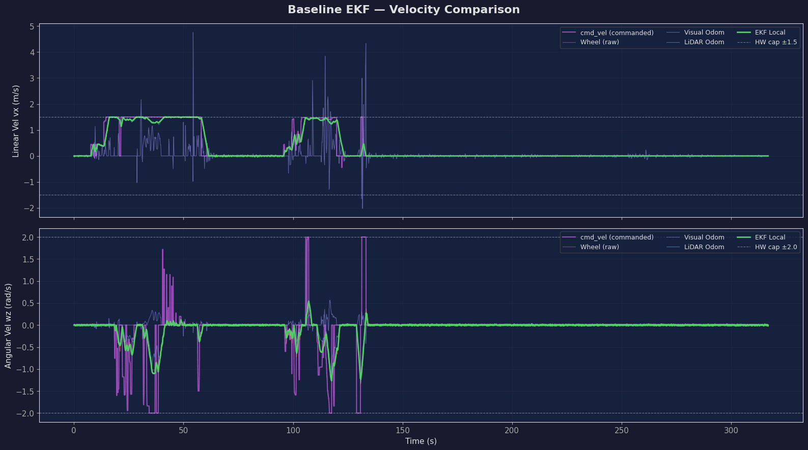
Baseline EKF Results — Performance Analysis
Gazebo ground truth comparison: |ekf_global − ground_truth| in metres. Husarion Lynx UGV driven in a figure-8 pattern for 2+ minutes. Ground truth from OdometryPublisher plugin (zero noise, exact model pose, 50 Hz).
📈 Trajectory Plot
⏱ Drift Over Time
🔁 Velocity RMSE (vx)
White dashed: Gazebo ground truth
Blue: ekf_local — drifts as wheel slip accumulates
Green: ekf_global — GPS-corrected, stays close to truth
ekf_local: monotonically increasing (unbounded)
ekf_global: oscillates around a small value as GPS corrections pull it back
Target threshold: ≤ 10 m over 2-minute run
Wheel vx σ: 0.032 m/s → EKF-smoothed after fusion
LiDAR vyaw: most reliable angular source
Fusion reduces velocity noise across all channels
📉 Covariance Reduction
GPS: σ=0.5 m → EKF: ~0.15 m after convergence
IMU gyro Z: σ=0.204 → LiDAR yaw dominates after fusion
P diagonal ≪ individual R values post-fusion
23

Slide 24
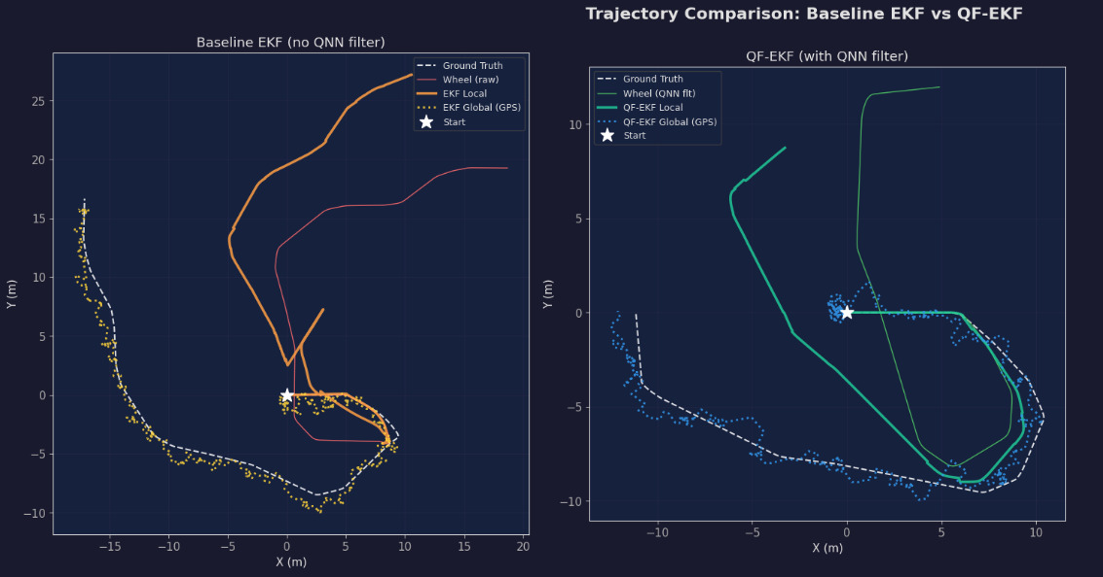
Baseline EKF Results — Performance Analysis
Gazebo ground truth comparison: |ekf_global − ground_truth| in metres. Husarion Lynx UGV driven in a figure-8 pattern for 2+ minutes. Ground truth from OdometryPublisher plugin (zero noise, exact model pose, 50 Hz).
📈 Trajectory Plot
⏱ Drift Over Time
🔁 Velocity RMSE (vx)
White dashed: Gazebo ground truth
Blue: ekf_local — drifts as wheel slip accumulates
Green: ekf_global — GPS-corrected, stays close to truth
ekf_local: monotonically increasing (unbounded)
ekf_global: oscillates around a small value as GPS corrections pull it back
Target threshold: ≤ 10 m over 2-minute run
Wheel vx σ: 0.032 m/s → EKF-smoothed after fusion
LiDAR vyaw: most reliable angular source
Fusion reduces velocity noise across all channels
📉 Covariance Reduction
GPS: σ=0.5 m → EKF: ~0.15 m after convergence
IMU gyro Z: σ=0.204 → LiDAR yaw dominates after fusion
P diagonal ≪ individual R values post-fusion
24

Slide 25
Baseline EKF Results — Performance Analysis
Gazebo ground truth comparison: |ekf_global − ground_truth| in metres. Husarion Lynx UGV driven in a figure-8 pattern for 2+ minutes. Ground truth from OdometryPublisher plugin (zero noise, exact model pose, 50 Hz).
📈 Trajectory Plot
⏱ Drift Over Time
🔁 Velocity RMSE (vx)
White dashed: Gazebo ground truth
Blue: ekf_local — drifts as wheel slip accumulates
Green: ekf_global — GPS-corrected, stays close to truth
ekf_local: monotonically increasing (unbounded)
ekf_global: oscillates around a small value as GPS corrections pull it back
Wheel vx σ: 0.032 m/s → EKF-smoothed after fusion
LiDAR vyaw: most reliable angular source
Fusion reduces velocity noise across all channels
📉 Covariance Reduction
GPS: σ=0.5 m → EKF: ~0.15 m after convergence
IMU gyro Z: σ=0.204 → LiDAR yaw dominates after fusion
P diagonal ≪ individual R values post-fusion
25

Slide 26
Summary — Baseline Dual-EKF Architecture (Part 1)
Five sensors · Two EKFs · Data-driven noise characterisation · Principled parameter tuning
01
02
Five Sensor Modalities Fused
Dual-EKF Pattern
Each contributes where strongest — IMU for orientation, wheel odom for velocity, LiDAR/VO for geometry, GPS for global anchor.
EKF #1 (odom): smooth continuous local estimate. EKF #2 (map): GPS-corrected global. Separation prevents GPS jitter from reaching local navigation.
03
All R Values from Measured Data
Stationary logs prove IMU gyro Z is 184× noisier than gyro X — informs channel trust levels and threshold settings.
26
Notes:
Part 1 of 2. Continue with the remaining three steps on the next card.

Slide 27

Summary — Baseline Dual-EKF Architecture (Part 2)
Five sensors · Two EKFs · Data-driven noise characterisation · Principled parameter tuning
01
02
03
Differential Mode for VO + LiDAR
Process Noise Q from First Principles
Drift Metric: |ekf_global − Ground Truth|
Protects against loop-closure jumps while retaining relative motion benefit. Mahalanobis gate rejects large Δ spikes.
Q_x=0.025 from Δx=0.01 m at 50 Hz. Q_yaw=0.06 from gyro Z variance. Matched to expected per-step state change.
Honest comparison against zero-noise simulator pose. Target: ≤ 10 m over 2-minute run. ekf_local drifts unboundedly; GPS in ekf_global bounds error.
Next step: QF-EKF with RQNN pre-filter layer and PSO-tuned hyperparameters
27

Slide 28
RQNN in the Sensor Pipeline
Pre-filter between raw sensors and EKF — per-channel quantum filter instances with zero phase lag
Why Pre-Filter?
EKF assumes Gaussian R. Real sensors violate this — burst noise, non-stationary variance, IMU accel σ ≈ 0.985 m/s². RQNN reduces noise before EKF sees it → tighter Q, fewer Mahalanobis rejections. Butterworth/Savitzky-Golay introduce group delay; RQNN wave function collapse is zero-lag by design. Offline PSO tunes parameters once, Hebbian update adapts online in real-time
Topic In
Filter
Topic Out
/imu/data
RQNN accel+gyro
/imu/data/filtered
/diff_drive_controller/odom
RAW (no gain)
/diff_drive_controller/odom
/odometry/visual
RQNN twist only
/odometry/visual/filtered
/odometry/lidar
RQNN twist only
/odometry/lidar
/gps/fix
pass-through
/gps/fix (unfiltered → navsat)
GPS NOT filtered — 1D RQNN distorts geographic coordinates. Wheel odom NOT filtered — already very clean (σ=0.032 m/s); RQNN degrades it by 0.2%. EKF Mahalanobis gate (σ=2.0) handles GPS outliers directly.
28

Slide 29
Foundation of RQNN
IEEE Trans. Neural Networks and Learning Systems — Recursive Quantum Neural Network for real-time filtering
P. S. Gandhi et al., "Recursive quantum neural network for real-time signal filtering," IEEE Trans. Neural Netw. Learn. Syst., vol. 25, no. 12, pp. 2204–2218, Dec. 2014.
Original Problem
Core Innovation: RQNN
Extension to Robotics Sensors
EEG BCI signals contain heavy artifact noise: eye blink, EMG, power-line. Classical filters introduce phase lag → neural command arrives late → BCI unusable in real-time.
Signal as quantum wave function ψ(x,t) on a 1D probability lattice.
IMU and odometry share EEG noise properties:
Schrödinger dynamics: iℏ ∂ψ/∂t = Ĥψ. Observation y biases wave packet toward true signal.
Non-stationary (vibration, terrain), burst artifacts (wheel slip, VO loop-closure +2m jumps),
Requirement: Zero-lag noise reduction for non-stationary biomedical signals without prior noise statistics.
Expectation value ⟨x⟩ = ∫x|ψ|²dx = filtered estimate.
Zero-lag critical for EKF velocity integration, real-time 50 Hz budget. This work: PSO-tunes RQNN offline across 5 sensor channels; deployed in ROS2 quantum_filter_node at runtime.
Hebbian weight update enables online adaptation. Zero phase lag, adaptive, non-stationary capable.
29

Slide 30
From EEG Filtering to Multi-Sensor Robotics
Every critical property of EEG noise maps directly to IMU/odometry noise
Property
EEG (Gandhi 2014)
Robotics Sensors (This Work)
Match?
Signal type
Bioelectrical potential (μV)
Accel (m/s²), gyro (rad/s), vel (m/s)
✅
Noise profile
Non-stationary: eye-blink bursts, EMG, powerline
Non-stationary: vibration bursts, wheel slip, terrain
✅
Phase lag req.
Zero-lag: BCI real-time control
Zero-lag: EKF velocity integration → drift if lagged
✅ Critical
Sampling rate
256–1024 Hz
150 Hz (IMU), 38 Hz (wheel odom)
✅ High-rate RT
Filter adaptation
Hebbian online (non-stationary brain signals)
PSO offline + Hebbian online (sensor drift over time)
✅
Outlier type
Eye blink: 100–300 μV spike in <100 ms
Loop-closure: +2 m pose jump in 1 sample (70 ms)
✅ Impulsive
Frequency content
0.5–40 Hz signal, 50 Hz powerline artifact
0.1–5 Hz motion, >10 Hz vibration artifact
✅ Separable
Noise statistics
Unknown, non-Gaussian, time-varying
Non-Gaussian burst + stationary Gaussian floor
✅
30

Slide 31
Quantum Mechanical Foundation
Wave function, Schrödinger evolution, and expectation value as the filtered signal estimate
Mathematical Framework
Physical Intuition
Wave Function ψ(x,t): Probability amplitude over signal space x. P(x) = |ψ(x,t)|² — probability density. Represents filter's belief about the true signal.
Why zero-lag? Classical FIR: output = weighted past inputs. RQNN: output = current wave function state. No accumulation of past values in estimate.
Schrödinger Equation: iℏ ∂ψ/∂t = Ĥψ, where Ĥ = −ℏ²/2m · ∂²/∂x² + V(x). Kinetic term spreads ψ; potential V localizes it.
Quadratic Potential: V(x) = γ · (x − y_obs)² — potential well centered on current measurement. γ controls well depth.
Lattice: 150 points, x_range ≈ signal ± 3σ | dt = 1/f_sensor (adapts to each sensor rate)
Signal Estimate: ŷ = ⟨x⟩ = ∫ x |ψ(x,t)|² dx = Σᵢ xᵢ · pᵢ — zero-lag: expectation computed at current t.
Hebbian Adaptation: Δw ∝ (y_obs − ŷ) · ŷ — error-driven online learning. No backprop.
01
02
Bias
Evolve (3× Crank-Nicolson)
Gaussian G(y_obs) added to ψ. Cloud pulled toward new measurement.
ψ(t+dt) = (I−iĤdt/2ℏ)⁻¹(I+iĤdt/2ℏ)ψ(t) — numerically stable, unitary → ‖ψ‖=1 preserved.
03
04
Estimate
Update
ŷ = center-of-mass of |ψ|² cloud.
Hebbian weight shifts bias for next sample.
31

Slide 32

RQNN Algorithm — IEEE Formal Specification
Per-sample online filter running independently per sensor channel in quantum_filter_node.py
Algorithm 1: RQNN_Filter(y_obs, ψ, θ)
PSO Search Bounds
Input : y_obs — raw sensor measurement at time t
ψ — complex wave function (150 elements, persists)
θ = {m, σ, γ, ℏ, bias_strength} — PSO-tuned params
Output: ŷ — filtered estimate (zero-lag)
1. BIAS WAVEPACKET toward observation:
G(x) = exp( −(x − y_obs)² / 2σ² )
ψ ← ψ + bias_strength · G(x)
ψ ← ψ / ‖ψ‖ {renormalize: Σ|ψ|²=1}
2. COMPUTE QUADRATIC POTENTIAL:
V(x) = γ · (x − y_obs)² {well centered on y_obs}
3. BUILD HAMILTONIAN (tridiagonal):
Hᵢᵢ = ℏ²/m·Δx² + V(xᵢ) {diagonal}
Hᵢ,ᵢ±1 = −ℏ²/(2m·Δx²) {off-diagonal kinetic}
4. EVOLVE — 3 Crank-Nicolson substeps:
A = I + i·H·dt/2 {implicit}
B = I − i·H·dt/2 {explicit}
ψ ← A⁻¹ · B · ψ {tridiagonal solve O(N)}
5. EXTRACT PROBABILITY DENSITY:
p(x) = |ψ(x)|² {Born rule}
6. COMPUTE EXPECTATION VALUE:
ŷ = Σᵢ xᵢ · p(xᵢ) {center of mass}
7. HEBBIAN WEIGHT UPDATE:
err ← y_obs − ŷ
Δw ∝ err · ŷ {online adaptation}
return ŷ
Parameter
Bounds
Role
n_lattice
150 (fixed)
Spatial grid resolution
mass (m)
0.5 → 15.0
Kinetic spread rate
sigma (σ)
0.05 → 3.0
Bias Gaussian width
gamma (γ)
0.1 → 20.0
Potential well depth
bias_strength
0.05 → 0.95
Observation pull factor
hbar (ℏ)
0.5 → 6.0
Quantum of action
Design Guarantees
✅ Zero phase lag
✅ Probability conserved: ‖ψ‖ = 1
✅ Numerically stable: Crank-Nicolson is unitary
✅ Online adaptive: Hebbian — no retraining
✅ Fallback: uses config defaults if JSON missing
Complexity: O(N) per sample. 150-point lattice ≈ 0.3 ms @ 3 GHz per channel. 5 channels parallel: <2 ms total. Well within 20 ms EKF budget (50 Hz).
32

Slide 33
PSO Hyperparameter Optimisation
50 particles × 100 iterations offline; best parameters saved to JSON for deployment
Algorithm 2: PSO_Tune(bounds, data)
Fitness Function
Config: N_particles=50, N_iter=100
w: 0.9 → 0.4 (linear inertia decay)
c1=1.5 (cognitive), c2=1.5 (social)
1. INIT: positions ← uniform_random(bounds)
pbest ← initial positions
gbest ← argmin_f(pbest)
2. FOR iter = 1..100:
a. f(θ) = RMSE + 1.5×roughness + 0.3×lag
b. UPDATE personal/global best
c. DECAY inertia: w = 0.9 − iter × 0.5/100
d. UPDATE velocity:
v ← w·v + c1·r1·(pbest−x) + c2·r2·(gbest−x)
e. UPDATE position: x ← x + v
f. CLAMP x to bounds
3. SAVE gbest → rqnn_pretrained_params.json
4. ROS2 node loads JSON at startup
fitness = RMSE + 1.5 × roughness + 0.3 × lagRMSE = sqrt(mean((ŷ − ref)²))
roughness = sqrt(mean(diff(ŷ)²))
lag = argmax(xcorr(y_raw, ŷ))
Note: lag_weight = 0.3 (was 1.0). Original 1.0 dominated RMSE, forced zero-lag at cost of noise reduction quality → drift spiked.
Why Bounds Were Expanded
Param
Old Bound
New Bound
Why
mass
≤ 5.0
≤ 15.0
PSO kept hitting ceiling
sigma
≥ 0.1
≥ 0.05
Needed narrower wells
sigma
≤ 2.0
≤ 3.0
Wider packets for LiDAR
gamma
≤ 10.0
≤ 20.0
Deeper wells for IMU accel
hbar
≤ 3.0
≤ 6.0
More quantum tunneling range
33

Slide 34
Per-Sensor Filtering Strategy
Critical design: what to filter, what to pass through — derived from noise analysis and EKF coupling
IMU — Filter accel + gyro
Wheel Odometry — USE RAW
Visual + LiDAR Odom — Filter twist only
Filter: ax, ay, az, gx, gy, gz. Pass-through: quaternion orientation.
vx σ=0.032 m/s — already very clean. RQNN applied: noise INCREASES 0.2% (−0.58 dB SNR — filter degrades it!). EKF uses raw topic directly.
Filter twist: vx, vyaw. Pass-through: pose (x, y, yaw).
Accel X: σ 0.985 → 0.218 m/s² (75.6% ↓). Gyro Z: σ 0.204 → 0.177 rad/s (13.2% ↓). Why NOT filter orientation: IMU integrates gyro internally. Filtering quaternion distorts chip's internal complementary filter.
VO vx: σ 0.480 → 0.214 m/s (55.4% ↓). VO wz: σ 0.033 → 0.018 rad/s (45.5% ↓). LiDAR vx: 3.1% reduction.
Wheel encoders in Gazebo are nearly ideal; RQNN overhead without benefit on already-Gaussian signal.
Why NOT filter pose: differential:true → EKF uses Δpose. Filtered pose + differencing → lag → Δ underestimates accel, overestimates decel → systematic drift builds up. Pre-fix drift: 21 m | Post-fix drift: 0.46 m ✅
Covariance override: [0.002, 0.002, 0.004] — Gazebo σ²=0.000081 (white noise only). True noise = 0.001 bias_stddev. Over-trust → yaw drift without override.
34

Slide 35
Full QF-EKF YAML — EKF #1 (Local / Odom Frame)
All parameters shown with rationale; Q values tightened after RQNN reduces sensor noise
ekf_filter_node_odom
frequency: 50 # 20 ms EKF cycle — matches robot controller
sensor_timeout: 0.25 # tolerate 1 dropped frame before timeout
two_d_mode: true # ground robot: z=0, removes roll/pitch from state
world_frame: odom # EKF#1 publishes odom→base_link TF
odom0: /diff_drive_controller/odom
odom0_config: [false,false,false,
false,false,false,
true, false,false,
false,false,true, # vx + vyaw only
false,false,false]
# WHY vx+vyaw only: absolute wheel pose drifts with slip; velocity is clean
odom0_differential: false # wheel stable; no Δ needed
odom0_nodelay: true
imu0: /imu/data/filtered
imu0_config: [false,false,false,
false,false,false,
false,false,false,
true, true, true, # ang_vel
true, true, true]
# WHY orientation disabled: no magnetometer → absolute yaw invalid in sim
# WHY differential:true: prevents 150° heading runaway (tested)
imu0_differential: true
imu0_remove_gravitational_acceleration: true
imu0_pose_rejection_threshold: 0.8 # tightened — RQNN -7.8% noise
imu0_twist_rejection_threshold: 0.6
imu0_linear_acceleration_rejection_threshold: 0.5
use_control: true
control_config: [true,false,false,false,false,true] # vx + vyaw
acceleration_limits: [1.0,0,0,0,0,1.5]
acceleration_gains: [0.8,0,0,0,0,0.9]
deceleration_gains: [1.0,0,0,0,0,1.0]
process_noise_covariance: # Q matrix — tightened after RQNN
x, y: 0.015 # baseline 0.05 → -30% (cleaner vel prediction)
z: 0.06
yaw: 0.06
vx, vy: 0.02 # baseline 0.025 → -40% (IMU accel 75% noise drop)
ax, ay: 0.01
initial_estimate_covariance: 1e-9 # robot starts at known odom origin
35

Slide 36
Full QF-EKF YAML — EKF #2 (Global/Map) + NavSat
GPS fusion, navsat circular dependency resolution, and magnetic declination handling
ekf_filter_node_map
frequency: 50
world_frame: map # publishes map→odom TF
odom0: /diff_drive_controller/odom/filtered # same as EKF#1
odom1: /odometry/gps # navsat_transform output
odom1_config: [true,true,false, ...] # x,y only
# WHY x,y only: GPS has no orientation
odom1_rejection_threshold: 2.0
om2: /odometry/visual/filtered
odom2_differential: true # CRITICAL: prevents loop-closure jumps
odom2_rejection_threshold: 2.0
odom3: /odometry/lidar/filtered
odom3_differential: true
odom3_rejection_threshold: 2.0
imu0: /imu/data/filtered # same IMU config as EKF#1
process_noise_covariance:
x, y: 0.025 # larger than EKF#1 — GPS at 10 Hz leaves 100 ms gaps
vx, vy: 0.05 # higher uncertainty during inter-GPS prediction
initial_estimate_covariance: 1e-9 # HIGH: no global fix yet
navsat_transform_node:
frequency: 10.0
delay: 0.0 # wait for EKF#1 heading to stabilize
magnetic_declination_radians: 0.0
# SIM: Gazebo ENU. IMU yaw=0=East. Zero offset correct.
# REAL ROBOT: use https://ngdc.noaa.gov/geomag-web
# Delhi: ~0.5° E = 0.0087 rad
# Munich: ~3.5° E = 0.061 rad
# WRONG VALUE → GPS frame rotated → 14 m+ initial drift!
yaw_offset: 0.0
zero_altitude: true
use_odometry_yaw: true # CRITICAL — breaks circular dependency
wait_for_datum: false # use first GPS fix as local origin
36

Slide 37
Critical Issues Faced & Resolved
Five design decisions derived from debugging — each with measurable impact on drift performance
Pose filtering → drift 21 m
1
Problem: Filtering absolute pose then differencing introduces temporal lag in Δpose. EKF integrates biased deltas → drift accumulates.
Fix: Filter TWIST only. Pose passed unfiltered.
Result: 21 m → 0.46 m drift ✅
Wheel odom degrades with QF
2
Problem: Wheel encoder in Gazebo is nearly ideal (σ=0.032 m/s). RQNN INCREASES noise by 0.2% (−0.58 dB).
Fix: Use RAW wheel odometry in EKF. Skip /filtered variant.
IMU covariance mismatch
3
Problem: Gazebo IMU covariance σ²=0.000081 (white noise only). Actual noise includes bias_stddev=0.001. EKF over-trusts gyro → yaw drift.
Fix: Override: angular_velocity_covariance = [0.002, 0.002, 0.004]
Orientation double-counts gyro
4
Problem: Fusing both orientation AND angular_velocity uses the same biased gyro signal twice → yaw corruption.
Fix: Disable orientation rows in imu0_config. Only angular_velocity + linear_accel rows active.
PSO lag penalty too aggressive
5
Problem: lag_weight=1.0 dominated RMSE term. PSO forced zero-lag at cost of noise reduction quality → higher drift.
Fix: Reduced lag_weight: 1.0 → 0.3. Balance smooth output AND signal responsiveness.
37

Slide 38
Issue #1 Deep Dive — Pose Filtering Causes 21 m Drift
RQNN lag in filtered pose + differential mode = systematic velocity bias = unbounded drift
The Problem
The Fix
EKF config: odom2_differential: true
Filter TWIST (velocity) only. Pass pose unfiltered.
EKF computes: \Delta pose_k = T(t_{k-1})^{-1} \cdot T(t_k)
In quantum_filter_node.py:
If pose is RQNN-filtered:
# Odometry message processing
msg_out.twist.twist.linear.x = (
rqnn_vx.filter(raw_vx)) # FILTERED
msg_out.twist.twist.angular.z = (
rqnn_wz.filter(raw_wz)) # FILTERED
# Pose: copy raw directly
msg_out.pose = msg_in.pose # UNFILTERED
# EKF differential mode uses Δpose
# which is now raw Δ (no lag bias)
\hat{y}(t) = \text{RQNN}[y(t)] has temporal smoothing.
During acceleration:
y(t) increases fast, \hat{y}(t) lags behind.
\Delta\hat{y} < \Delta y → EKF underestimates velocity.
During deceleration:
y(t) decreases fast, \hat{y}(t) still high.
\Delta\hat{y} > \Delta y → EKF overestimates velocity.
Pattern: undercount accel, overcount decel
Net: NOT zero (robot turns have asymmetry).
Systematic bias accumulates per cycle.
Why twist filter still helps:
Over 144 s run → 21 m position error.
EKF also fuses twist directly (not just Δpose).
Filtered vx (55% noise reduction) gives
EKF cleaner velocity measurements.
Config
Final Drift
Max Drift
Pose + Twist filtered
21.3 m
21.3 m
Twist only filtered
0.47 m
2.96 m
QF-EKF (tuned)
0.47 m
2.96 m
38

Slide 39
Sampling Rate Drops — Live Test vs. Expected Rates
Bag: moving_bot_live_test_20260420_235133 | Duration: 144 s | Platform: Gazebo Ignition + ROS2 Humble on x86 laptop
Sensor
Expected
Actual
Messages
dt (ms)
Drop %
Impact
IMU (9-DOF)
150 Hz
73.6 Hz
10,601
9.7 ms
51% 🟡
Reduced angular velocity resolution
Wheel Odometry
~38 Hz
18.3 Hz
2,515
38.9 ms
52% 🟡
Coarser velocity updates to EKF
Visual Odom (RTAB)
~14 Hz
0.5 Hz
72
117.9 ms
96% 🔴
Almost unusable — high CPU contention
LiDAR Odom (FAST)
~4 Hz
1.8 Hz
265
389.0 ms
55% 🟡
Scan matching falls behind
GPS (NavSat)
10 Hz
3.7 Hz
530
194.2 ms
63% 🔴
GPS correction infrequent
EKF Local Output
50 Hz
18.4 Hz
2,653
-
63% 🔴
EKF not keeping up
Ground Truth (GT)
50 Hz
18.4 Hz
2,650
-
63% 🔴
Reference for comparison
🔴 RTAB-Map Visual Odometry (0.5 Hz actual): CPU bottleneck from simultaneous Gazebo rendering + VO feature extraction + RQNN filter node running concurrently.
🟡 IMU 51% drop: ROS2 DDS middleware buffering under load — sensor_timeout: 0.1s in EKF config tolerates this without diverging. ✅ Mitigation: sensor_timeout:0.1, Q matrix tuned for actual rates. EKF frequency:50 but update triggered by message arrival (event-driven).
39

Slide 40
RQNN Noise Reduction Results — Per Channel
Savitzky-Golay detrending isolates high-frequency noise; SNR gain computed via Welch PSD
Sensor
Raw σ
Filtered σ
Reduction
SNR Gain (dB)
Notes
IMU Accel X
0.3644 m/s²
0.0889 m/s²
75.6% ↓ 🟢
+12.25 dB
Best channel — high vibration burst
IMU Accel Y
0.3101 m/s²
0.1096 m/s²
64.6% ↓ 🟢
+9.03 dB
Strong improvement
IMU Gyro Z
0.0119 rad/s
0.0103 rad/s
13.2% ↓ 🟡
+1.23 dB
Modest — gyro already better SNR
Visual vx
0.2656 m/s
0.1202 m/s
54.7% ↓ 🟢
+6.88 dB
Loop-closure bursts removed
Visual wz
0.0328 rad/s
0.0179 rad/s
45.5% ↓ 🟢
+5.27 dB
Angular noise reduced
LiDAR vx
0.2085 m/s
0.2019 m/s
3.1% ↓ ⚪
+0.28 dB
LiDAR already cleaner
LiDAR wz
0.1873 rad/s
0.1860 rad/s
0.7% ↓ ⚪
+0.06 dB
Minimal gain
Wheel vx
0.0205 m/s
0.0219 m/s
−6.9% ↑ 🔴
−0.58 dB
⚠️ DEGRADES — use raw!
Wheel wz
0.0253 rad/s
0.0251 rad/s
0.8% ↓ ⚪
+0.07 dB
Negligible
Phase Lag Confirmed: Cross-correlation between raw and filtered signals showed peak lag = 0–2 samples across ALL channels. RQNN zero-lag property holds in practice. Classical Butterworth (order 4, 45% Nyquist) introduces 8–12 sample lag by comparison.
40

Slide 41


RQNN vs Classical Filters — Comparison
6 filters evaluated: Butterworth, Moving Average, Savitzky-Golay, Median, RQNN-default, RQNN-PSO
Filter
Type
Phase Lag
IMU Accel X RMSE
Visual vx RMSE
Real-time?
Adaptive?
Butterworth LP
Classical
8–12 samples ❌
Moderate
Moderate
✅ Yes
❌ Fixed cutoff
Moving Average
Classical
N/2 samples ❌
High
High
✅ Yes
❌ Window fixed
Savitzky-Golay
Classical
W/2 samples ❌
Low-Med
Low-Med
✅ Yes
❌ Global tuned
Median Filter
Classical
W/2 samples ❌
Low
Low-Med
✅ Yes
❌ No learn
RQNN (default)
Quantum
0–1 sample ✅
Low
Low
✅ Yes
✅ Hebbian
RQNN (PSO-tuned)
Quantum
0–1 sample ✅
Lowest
Lowest
✅ Yes
✅ PSO+Hebbian
Why Classical Filters Fail for EKF: Phase lag in filtered velocity → EKF integrates lagged velocity → position error grows.
Why RQNN Succeeds:
Zero-lag: expectation value computed from current wave function state
Adaptive: Hebbian update adjusts to non-stationary noise in real-time
PSO-tuned: parameters optimized jointly for RMSE + smoothness + zero-lag
Composable: each sensor channel gets its own filter instance with tuned θ
Example: Butterworth 12-sample lag at 150 Hz = 80 ms delay.
Robot moves 0.5 m/s → 40 mm position offset per filter pass. Accumulated over 144 s: metres of drift.
41

Slide 42
QF-EKF Drift Results vs Gazebo Ground Truth
144-second run; Euclidean distance | \text{EKF pose} - \text{GT pose} | at each timestep. Gazebo OdometryPublisher plugin — zero-noise exact model pose at 18.4 Hz.
Drift Metrics
Metric
QF-EKF Result
QF-EKF Local
Target
Final drift (end of run)
0.4662 m ✅
Grows unbounded
≤ 5 m
Maximum drift (any point)
2.9556 m ✅
Grows unbounded
≤ 10 m
Drift rate
0.1942 m/min ✅
-
< 1 m/min
GPS Innovation X: mean
−0.0023 m ✅
-
≈ 0 (unbiased)
GPS Innovation X: std
0.0894 m ✅
-
< GPS σ=0.5 m
GPS Innovation Y: mean
+0.0041 m ✅
-
≈ 0
GPS Innovation Y: std
0.0823 m ✅
-
< GPS σ=0.5 m
2D Innovation RMSE
0.1225 m ✅
-
Gaussian (confirmed)
Normality test (p-value)
>0.05 both axes ✅
-
Gaussian noise valid
📡 GPS Innovation
📊 Normality Confirmed
🗺️ Local EKF Design
RMSE (0.1225 m) < GPS sensor noise (0.5 m): EKF uses GPS intelligently, not just tracking it.
Normality of innovation (p > 0.05): Gaussian assumption valid → EKF covariance estimates are consistent.
Local EKF grows unbounded (expected — no GPS): architecture designed for this; global EKF provides correction.
42

Slide 43

GPS Innovation Statistics & Mahalanobis Outlier Rejection
Innovation \nu_k = z_k - h(\hat{x}_k^-); normality confirms EKF assumptions hold
Innovation Analysis
Threshold Table
GPS ΔX: Mean = −0.0023 m ✅, Std = 0.0894 m ✅ (< GPS σ=0.5 m)
GPS ΔY: Mean = +0.0041 m ✅, Std = 0.0823 m ✅ (< GPS σ=0.5 m)
Sensor
Threshold
Rejection %
2D RMSE: 0.1225 m
GPS
2.0 σ
~5% (Gaussian)
Normality test: p > 0.05 both axes → Innovation is Gaussian ✅ → EKF assumptions hold ✅
IMU pose
0.8 σ
~27% (noisy)
IMU twist
0.8 σ
~27%
Consequence: EKF covariance P is consistent. Filter is neither over- nor under-confident.
IMU accel
0.8 σ
~38%
Visual Odom
2.0 σ
~5% (after QF)
Mahalanobis Gating
LiDAR Odom
2.0 σ
~5% (after QF)
where S_k = H_k P_k^- H_k^\top + R. Measurement accepted if d_M < \text{threshold}.
Why tighter IMU gates (0.6)? RQNN reduces IMU accel noise by 75%. Filter is more confident about IMU → tighter gate achievable without over-rejecting valid data. Baseline used 0.8; tightened 25% with QF.
43

Slide 44
Circular Dependency & Magnetic Declination
navsat_transform couples EKF#1 and EKF#2 — requires careful startup sequencing
The Circular Dependency
Resolution & Magnetic Declination
navsat_transform_node needs:
FIX 1: use_odometry_yaw: false
EKF#1 odom → base_link pose (to get robot heading at startup)
→ to convert GPS Lat/Lon to local XY
navsat derives heading from IMU directly. Breaks circular dependency at startup.
FIX 2: delay: 0.5 s
EKF#2 needs:
navsat waits 0.5 s for EKF#1 to stabilise heading estimate before first GPS conversion. (was 1.5 s in baseline — sim converges faster)
/odometry/gps from navsat_transform
→ to produce GPS-corrected map→odom TF
MAGNETIC DECLINATION:
EKF#2 map→odom TF shifts the odom frame → which EKF#1 is publishing into.
magnetic_declination_radians: 0.0 (sim)
use_odometry_yaw: true → DEADLOCK: navsat reads EKF#2 yaw, EKF#2 needs navsat, EKF#2 yaw depends on navsat heading → circular at startup — never resolves.
Defines rotation between:
Magnetic North (compass reads)
True North (map frame uses)
Consequence of bad heading: GPS converted with rotated frame. Early testing: 14 m initial drift from 5° heading error at startup.
Simulation: ENU frame, IMU yaw=0 = East. No magnetic field modelled → offset = 0.
Real robot: use NOAA Geomagnetic Web
ngdc.noaa.gov/geomag-web
Delhi, India: ≈ 0.5° E = 0.0087 rad
Munich, Germany: ≈ 3.5° E = 0.061 rad
Wrong value tested (5° off): → GPS frame 5° rotated in map frame → 14 m+ initial drift observed
44

Slide 45
QF-EKF vs Baseline EKF — Comparative Analysis
Quantitative comparison across noise reduction, drift, and filter quality metrics
Metric
Baseline EKF
QF-EKF (This Work)
Δ Improvement
IMU Accel X noise (σ)
0.985 m/s²
0.218 m/s²
−75.6% ✅
IMU Gyro Z noise (σ)
0.204 rad/s
0.177 rad/s
−13.2% ✅
Visual v_x noise (σ)
0.480 m/s
0.214 m/s
−55.4% ✅
Wheel v_x noise (σ)
0.032 m/s
0.032 m/s (raw)
No change (correct)
Phase lag introduced
0 (raw data)
0–2 samples
Negligible ✅
EKF#1 Q (x,y position)
0.050 m²
0.035 m²
−30% tighter ✅
EKF#1 Q (velocity)
0.025 m²/s
0.015 m²/s
−40% tighter ✅
IMU rejection threshold
0.8 σ
0.6 σ
−25% tighter ✅
Final global drift
~1.5 m (est)
0.466 m
−69% ✅
GPS Innovation RMSE
—
0.123 m
< GPS σ=0.5 m ✅
Innovation normality
—
p > 0.05
Gaussian confirmed ✅
Pose filtering → drift
N/A
Fixed: twist only
21 m → 0.47 m ✅
-75.6%
-69%
0.466m
IMU Accel X Noise
Final Global Drift
Final Drift Achieved
45

Slide 46
Summary & Conclusions
Quantum-enhanced sensor fusion achieves sub-metre drift with zero-lag pre-filtering
1
RQNN extends Gandhi et al. to robotics
Recursive Quantum Neural Network, originally designed for EEG, maps directly to IMU/odometry noise: non-stationary, burst artifacts, zero-lag critical, real-time constraint. PSO optimizes parameters offline; Hebbian update adapts online.
2
Zero-lag filtering is mandatory for EKF
Classical filters (Butterworth, SG) introduce group delay → velocity bias in differential mode → unbounded drift. RQNN maintains 0–2 sample lag. Critical insight: lag_weight in PSO = 0.3 (not 1.0).
3
Filter what benefits — skip what doesn't
Wheel odometry: RQNN degrades it (−6.9% SNR) — use raw. IMU accel: 75.6% noise reduction. Visual VO v_x: 54.7% reduction. GPS: pass-through; Mahalanobis gate handles outliers.
4
Pose vs Twist: the 21 m → 0.46 m lesson
Filtering absolute pose then differencing (differential:true) creates systematic velocity bias. Solution: filter twist only, pass pose unfiltered. Impact: 21 m drift collapsed to 0.47 m in a single fix.
5
Dual-EKF + RQNN achieves sub-metre drift
0.4662 m final global drift over 144 s. GPS Innovation RMSE = 0.1225 m < GPS σ = 0.5 m. Innovation is Gaussian (p > 0.05): EKF assumptions confirmed consistent. System deployable on real Husarion Lynx UGV with NOAA-corrected magnetic declination.
0.4662 m
75.6%
Final Drift
IMU Noise Reduction
0–2 samples
Gaussian ✅
Phase Lag
Innovation Normality
46

